Slide 1
Update
2026-05-29

Slide 2
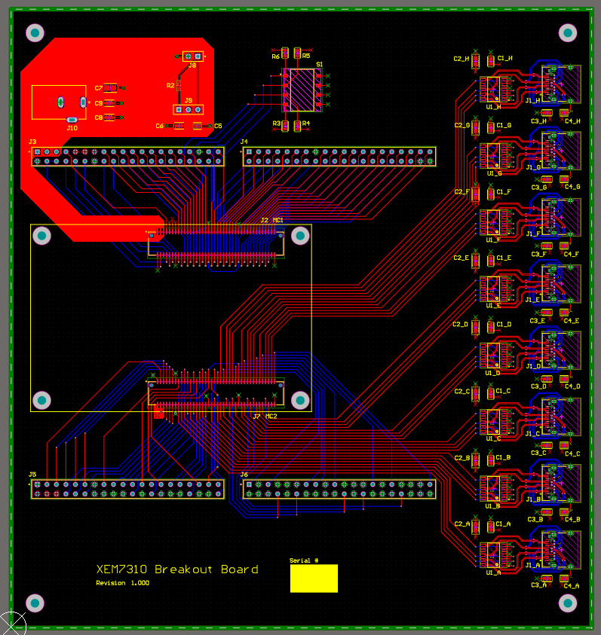
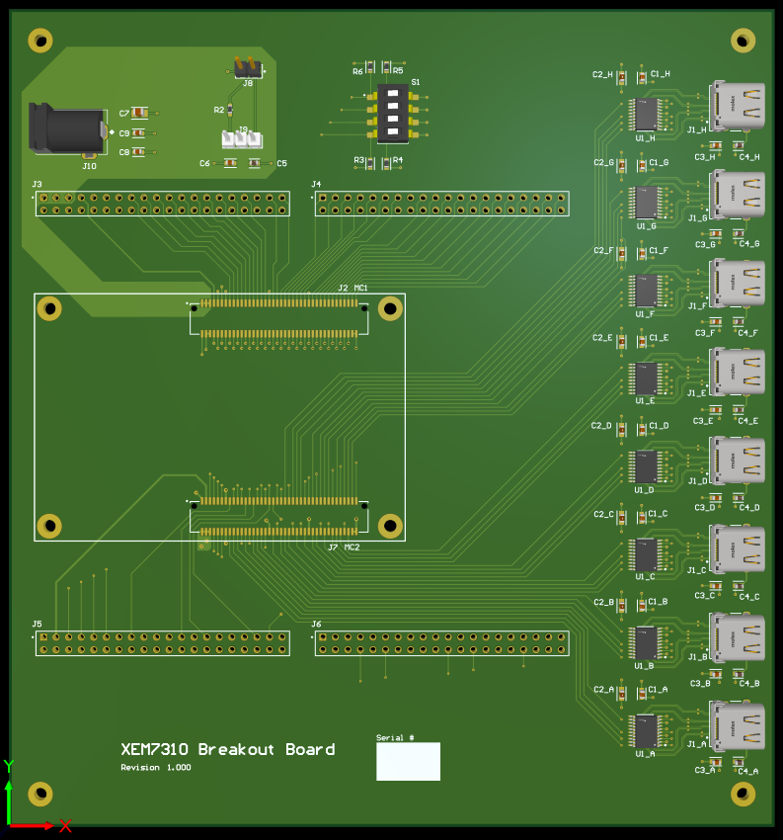
Breakout Board

Slide 3
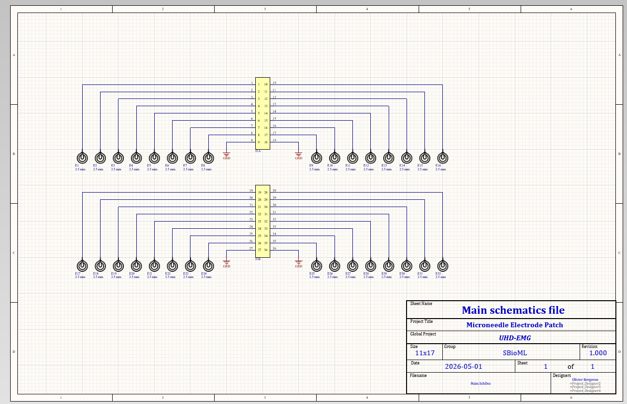
Schematics are done
Footprints and PCB
Just started

Slide 4
Intan with USB
Need to do a modification to David-Alexandre’s files
Omnetics connector -> Standard ZIF connector

Slide 5
TODO list
Finish breakout board
Continue with microneedle sample
Start to look at David-Alexandre’s Intan files

